Slide 1
Hospital Performance & Readmission Analytics System
Healthcare Analytics Project

Slide 2
Dataset Overview
The project uses 10,000+ hospital records:
Patient Master Data – Demographics & admission details
Insurance Claims Data – Claim status & settlement details
Treatment Cost Data – Cost breakdown per patient
Hospital Operations Data – Bed occupancy & staffing

Slide 3

Business Objectives
Monitor overall readmission rate
Identify high-risk patient segments
Reduce claim rejection losses
Improve payer settlement efficiency
Optimize bed occupancy and staffing
Develop executive-level KPI dashboard

Slide 4
Data Cleaning Approach (Excel)
Performed complete data cleaning in Excel:
Standardized Gender, Department & Insurance Type
Created Age Band column
Calculated Length of Stay (LOS)
Created Readmission Flag
Removed negative financial values
Validated date inconsistencies
Exported cleaned CSV files

Slide 5
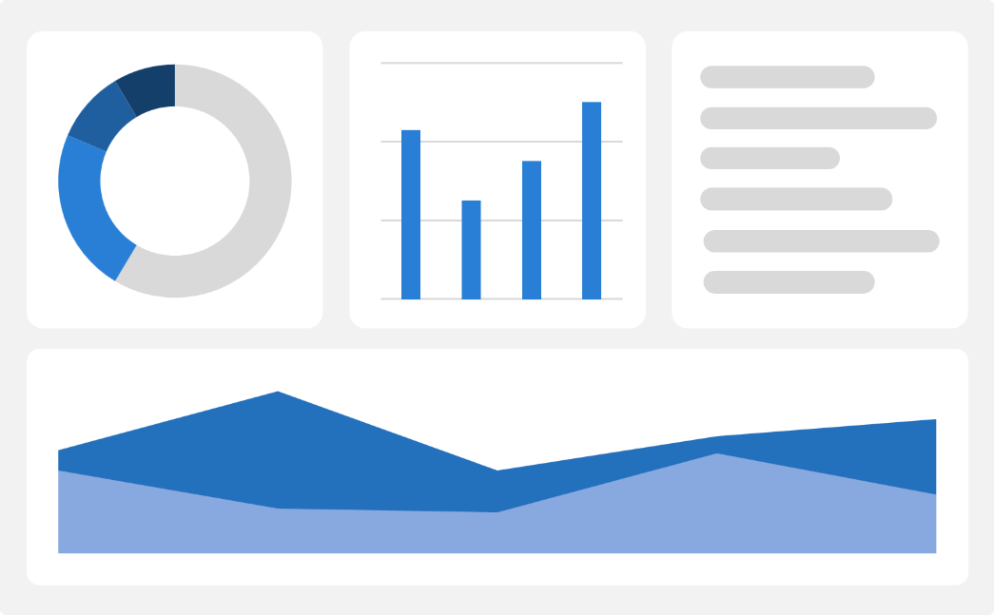
Null Handling Strategy
< 5% Null → Replaced with Median
5–20% Null → Replaced with Median + documented assumption
20% Null → Flagged column
Categorical Null → Replaced with “Unknown”
Admission Date Null → Record removed
Settlement Date Null → Marked as Pending

Slide 6
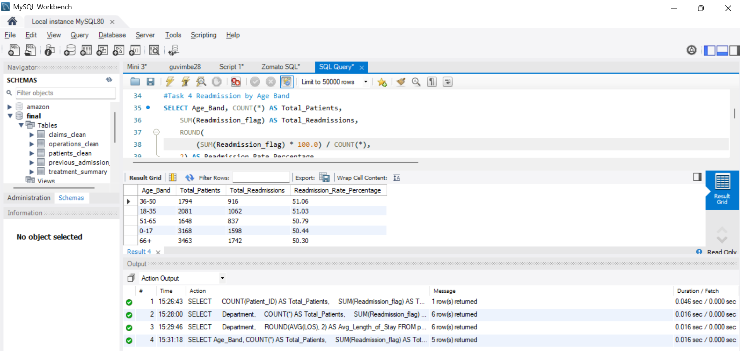
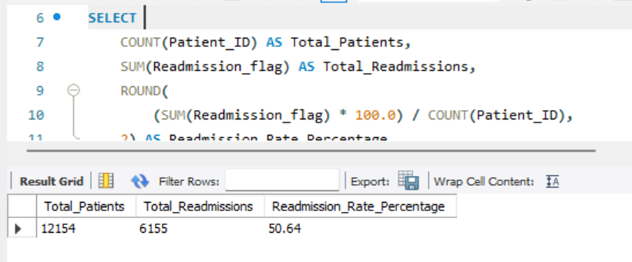
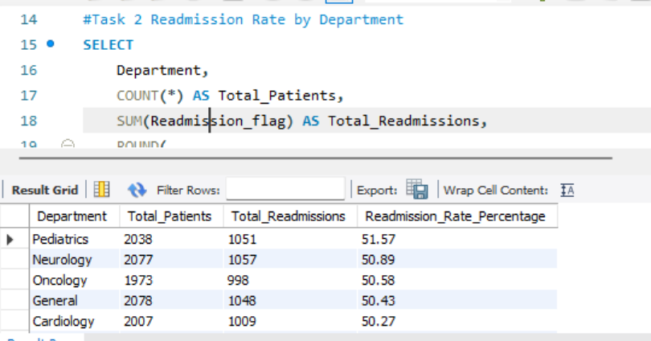
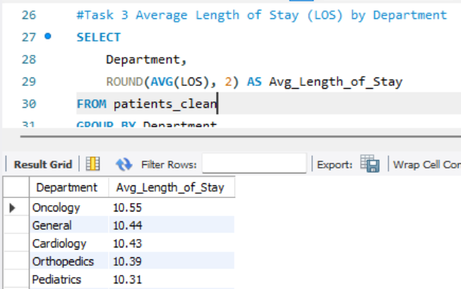
MySQL Implementation
Created schema in MySQL
Imported cleaned CSV files
Validated row counts
Created analytical queries (15+)
Used aggregation, grouping & conditional logic

Slide 7
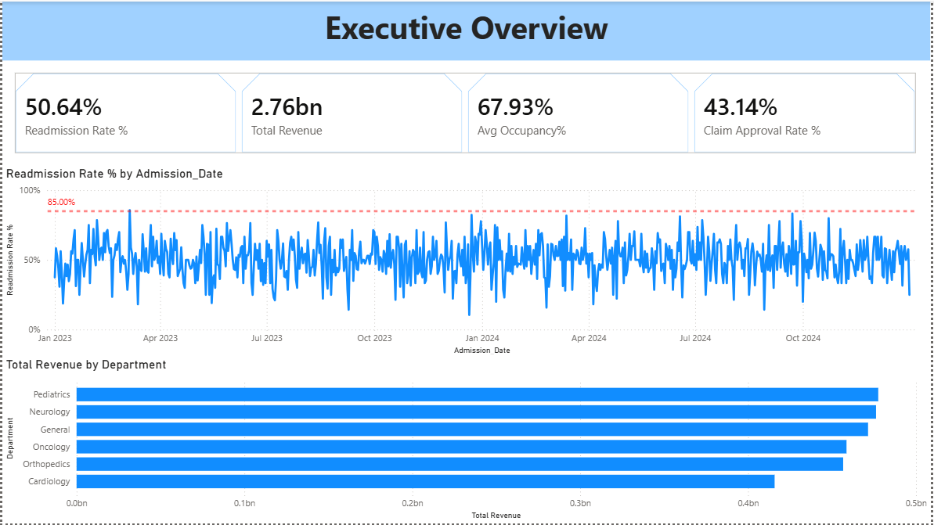
Executive Dashboard Overview
Key Highlights:
Trend Insights
The monthly readmission trend shows fluctuations throughout the year, with some periods crossing the 85% threshold.
Revenue Insights
Readmission Rate: 50.64%
Total Revenue: 2.76 Billion
Average Occupancy: 67.93%
Claim Approval Rate: 43.14%
Pediatrics and Neurology are the top revenue-generating departments.
Cardiology generates comparatively lower revenue
Recommendation:
Strengthen discharge planning and post-discharge monitoring to reduce readmissions.
Monitor occupancy trends to avoid overcapacity-related risks.

Slide 8
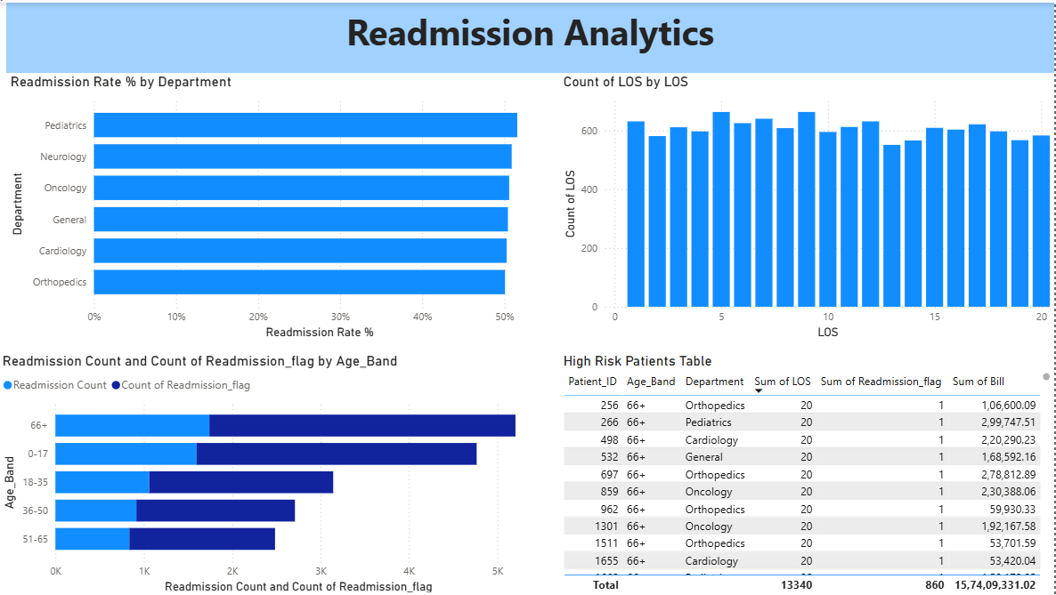
Readmission Analytics
.
.
Department-Level Insights
Readmission rates are consistently high across departments (~50%).
Pediatrics and Neurology show slightly higher readmission rates compared to other departments
Length of Stay (LOS) Analysis
Readmissions are more common among patients with longer LOS (around 15–20 days).
Higher LOS may indicate severe conditions or complications.
Action: Focus on discharge readiness assessment for long-stay patients.
Age-Based Risk Analysis
66+ age group has the highest readmission count.
Younger age groups (0–17, 18–35) show comparatively lower readmission impact
Action: Implement elderly care follow-up programs and home monitoring support.

Slide 9
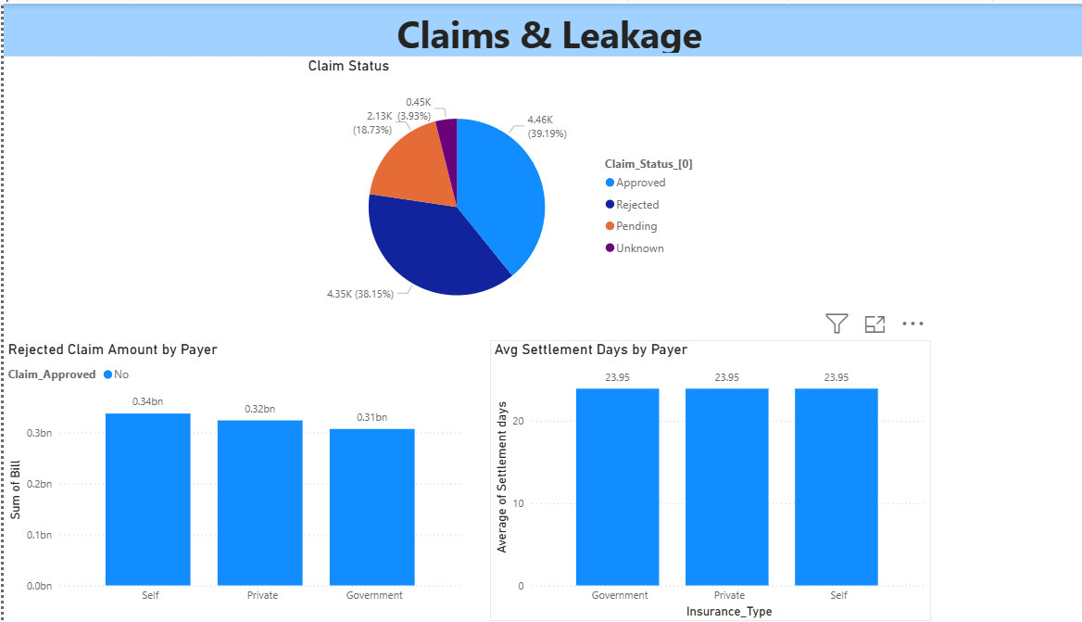
Claims & Leakage
1.Claim Status Overview
39% Approved Claims
38% Rejected Claims
18% Pending Claims
Small % marked as Unknown
Action:Improve documentation accuracy
2.Rejected Claim Amount by Payer
Self-pay patients show the highest rejected bill amount (~0.34bn)
Followed by Private insurance (~0.32bn)
Government payers have slightly lower rejected amounts (~0.31bn)
Action: Enhance claim verification before submission
3.Average Settlement Days by Payer
Average settlement time across all payer types is ~24 days.
No major variation among Government, Private, and Self.
Action: Focus more on approval rate improvement rather than settlement speed.

Slide 10
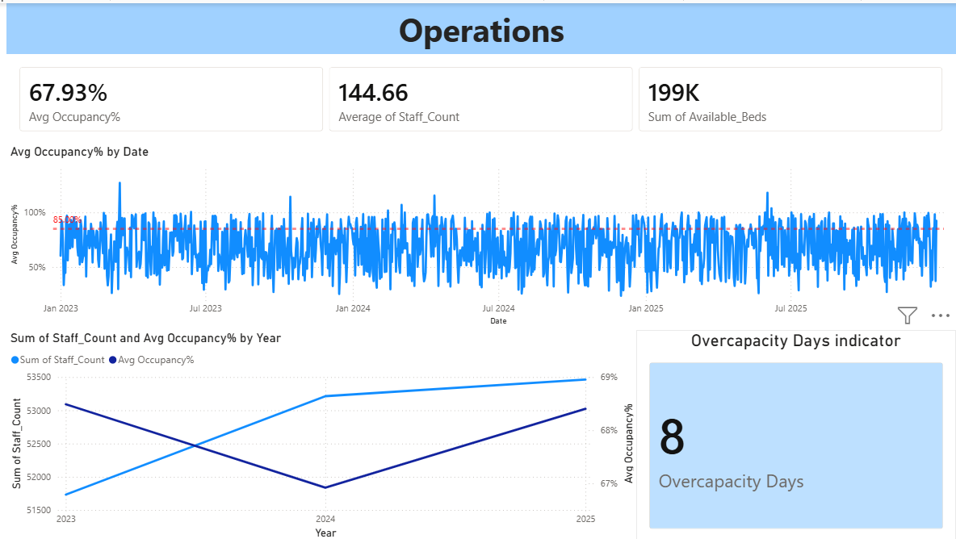
Claims & Leakage
1.Key Operational KPIs
Average Occupancy Rate: 67.93% Indicates moderate bed utilization.
Average Staff Count: 144.66 Staffing levels appear stable across the observed period.
Total Available Beds: 199K Reflects overall operational capacity.
2.Occupancy Trend Analysis
Daily occupancy shows high variability.
Certain periods cross the 85% threshold, indicating potential stress periods.
4.Overcapacity Monitoring
8 Overcapacity Days recorded.
These days may correlate with:
Increased readmission rates
Action: Maintain buffer staffing during high-demand periods.
3.Staffing vs Occupancy Trend
Staff count has gradually increased from 2023 to 2025.
Occupancy slightly declined in 2024 but improved again in 2025

Slide 11
Operational Insights
1.Departments with Highest Readmission
Analysis shows that Pediatrics and Neurology departments have the highest readmission rates compared to other departments.
Recommendation: Strengthen follow-up care and discharge planning in high-risk departments.
2. Relationship Between LOS and Readmission
Patients with longer Length of Stay (LOS) tend to have a higher probability of readmission.
Insight: Patients with LOS greater than average should be monitored more closely after discharge.
3. Overcapacity Days and Readmission Spikes
The analysis identified 8 overcapacity days where occupied beds exceeded available beds.
During these periods, hospitals may experience:
Increased risk of early discharge or complications.
Conclusion: Overcapacity situations can contribute to higher readmission rates
Recommendation:
Improve bed capacity planning
Increase staff allocation during peak demand

Slide 12
Financial Insights
Revenue at Risk due to Rejected Claims
A significant portion of hospital revenue is impacted by rejected insurance claims.
Rejected claims from Self, Private, and Government insurance types contribute to revenue leakage.
Impact: Claim rejections delay hospital cash flow and reduce financial stability.
2.Settlement Cycle Analysis
The average settlement time is approximately 24 days across insurance providers.
Recommendation: Improve claim documentation and follow-up processes to reduce settlement delays.
3. Top Revenue Generating Departments
Departments such as Pediatrics, Neurology, and General Medicine generate the highest revenue.
These departments handle high patient volumes and complex treatments.
Insight: Investing in these departments can increase hospital profitability.

Slide 13
Risk Insights
Age Group with Highest Readmissions
The 66+ age band has the highest readmission rate.
Elderly patients often have:
Chronic diseases
Multiple health complications
Higher recovery time.
Insight: Elderly patients require stronger post-discharge monitoring.
2.High-Risk Patient Profile
Patients with the following characteristics show higher readmission risk:
Age above 65
Long Length of Stay (LOS)
History of previous admissions
Conclusion: Early identification of high-risk patients can reduce readmission.
3. Department Risk Patterns
Departments such as Orthopedics and Oncology show higher LOS and readmission.
Recommendation: Introduce special discharge protocols for high-risk departments.

Slide 14
Final Recommendation
Based on the analysis, the following improvements are recommended:
Strengthen discharge planning
Implement post-discharge follow-up programs
Monitor high-risk patients
Improve claim submission quality
Improve bed utilization planning
Increase staff allocation during peak occupancy
Monitor overcapacity days
Monitor KPIs such as Readmission Rate, Revenue, and Occupancy

Slide 15
Summary
Project Objective
To analyze hospital performance using healthcare data analytics and identify key drivers of readmission, revenue leakage, and operational inefficiencies.
Key Findings
50.64% readmission rate indicates a potential operational concern.
Claim approval rate is 43.14%, showing significant financial leakage.
Average occupancy is 67.93%, with 8 overcapacity days identified.
Elderly patients (66+ age group) show the highest readmission risk.
Business Value
This analytics solution helps hospital management to:
Identify high-risk patients
Improve claim approval efficiency
Optimize bed and staff utilization
Monitor revenue performance

Slide 16

Thank you

